Slide 1
Ad Click Prediction
MSBA Team 5: Henry Dimlow, Pandora Shou, Zayn Sui, Cindy Zhang

Slide 2
Table of Contents
01
02
03
Business Understanding
Data
Understanding
Data
Preparation
04
05
06
Modeling
Evaluation
Deployment

Slide 3
Business Understanding
Our Business Problem: Can we predict if a customer will open and click through an advertisement sent to their email?
When will this be useful?: Businesses can predict the number of customers who would click on an ad
Know how customers respond to different emails
When Would we use this model?: Use this prediction before a company launches a new product or ad campaign
Notes:
Our Business Problem: Can we predict if a customer will open and click through an advertisement sent to their email
When will this be useful?: This will be useful as it would allow businesses to predict the number of customers who would click on an ad before starting an ad campaign
When will this be useful?: Knowing how customers respond to different emails would allow companies to tailor their emails based on what they hope to gain from each ad campaign
When Would we use this model?: Use this prediction could be used before a company launches a new product or ad campaign giving the business an estimate of people who will open and click through their new ad.

Slide 4
Data: Email Campaign Dataset - 3 Tables
Email
Link_Clicked
Email_Opened
Records of campaign email sent
100,000 emails
The list of emails with the campaign link clicked
2,119 emails
The list of emails that customers have opened
10,345 emails
Notes:
Maybe only two tables are enough

Slide 5
Main Features
Email_text
Email_type
Hour
Weekday
User_country
User_past_
purchase
Binary: if the email is long or short
Binary: if email is generic or personalized
Numerical: the hour that email was sent
Polynomial: the weekday that email was sent
Polynomial: the country of user
Numerical: the number of past purchases of the customer

Slide 6
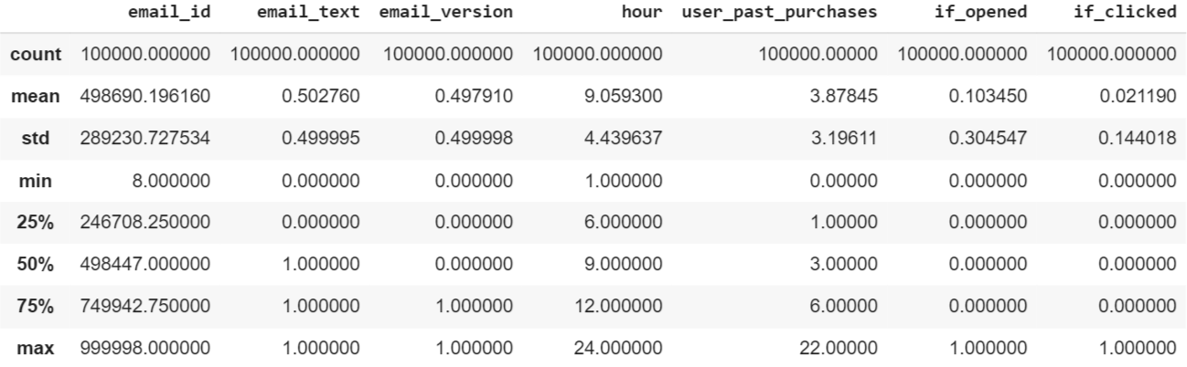
Exploratory Analysis
No missing or duplicate data
Summary statistics

Slide 7
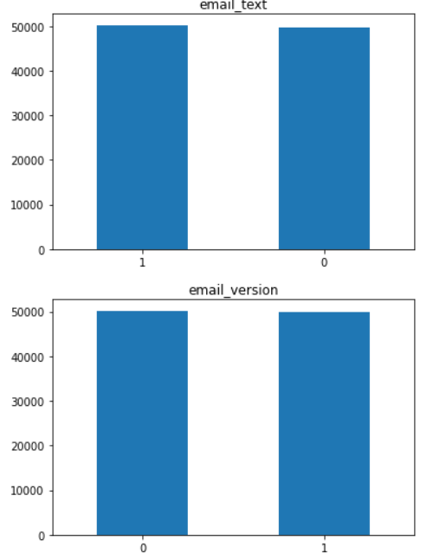
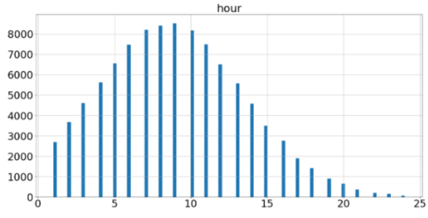
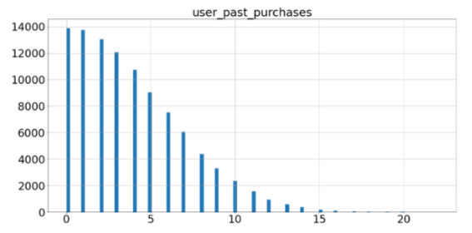
Exploratory Analysis: Histograms

Slide 8
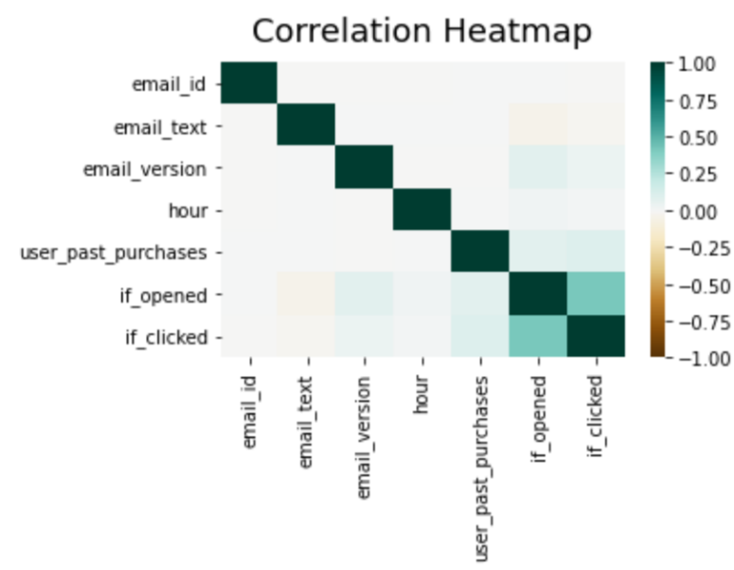
Exploratory Analysis: Correlation Heatmap

Slide 9
Data Preparation: Target Variable
Create Target Variable: If_clicked
If the customer who received the advertisement email has clicked through the link or not before the campaign ended
Criteria: if an email id from email_table appears in the link_clicked table, if_clicked = 1
Distribution: 2119 positive and 97881 negative

Slide 10
Data Preparation: Exclude Variables
Drop other variable: email_id
Variables |  |  |  |  |  |  |  | Target
email_id | email_text | email_version | hour | weekday | user_country | user_past_purchases | if_opened | if_clicked

Slide 11
Data Preparation: Categorical features
Nominal Attributes:
'User_country'
Ordinal Attributes:
'Hour'
'weekday
Binomial Attributes:
'Email_text'
'Email_version'
'if_opened'
Get dummies
Transform text to number
0/1
Variables |  |  |  |  |  |  |  | Target
email_id | email_text | email_version | hour | weekday | user_country | user_past_purchases | if_opened | if_clicked
 | 0/1 | 0/1 | number | number | dummy

Slide 12
Data Preparation: Transformation
Apply log transformation to user_past_purchases to deal with the right-skewed distribution.
Variables |  |  |  |  |  |  |  | Target
email_id | email_text | email_version | hour | weekday | user_country | user_past_purchases | if_opened | if_clicked
 | 0/1 | 0/1 |  |  | dummy | log

Slide 13
Data Preparation: Feature Engineering
Create a new feature : square of user_past_experience to increase complexity of attributes.
Variables |  |  |  |  |  |  |  | Target
email_id | email_text | email_version | hour | weekday | user_country | user_past_purchases | if_opened | if_clicked
 | 0/1 | 0/1 |  |  | dummy | log
 |  |  |  |  |  | User_past_purchases_ square

Slide 14
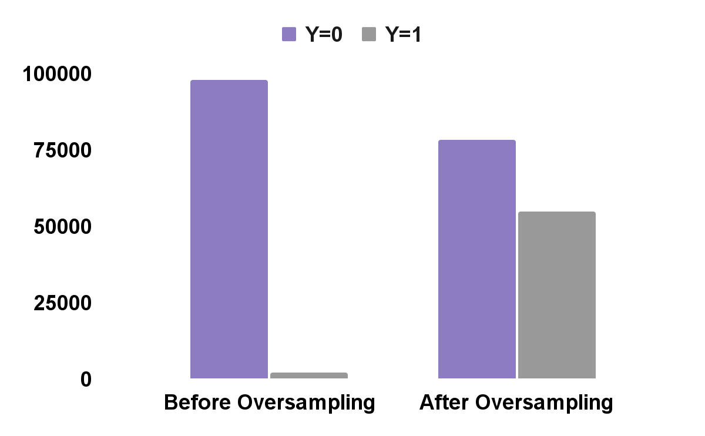
Data Preparation: Oversampling
- Among 100,000 emails in the dataset, in only 2.1% (about 2,119 emails) the advertisement has been clicked
- Deal with imbalance: Oversampling
- The after_oversampling proportion is 1 : 0.7
After train/ test split (ratio = 0.2/0.8)

Slide 15
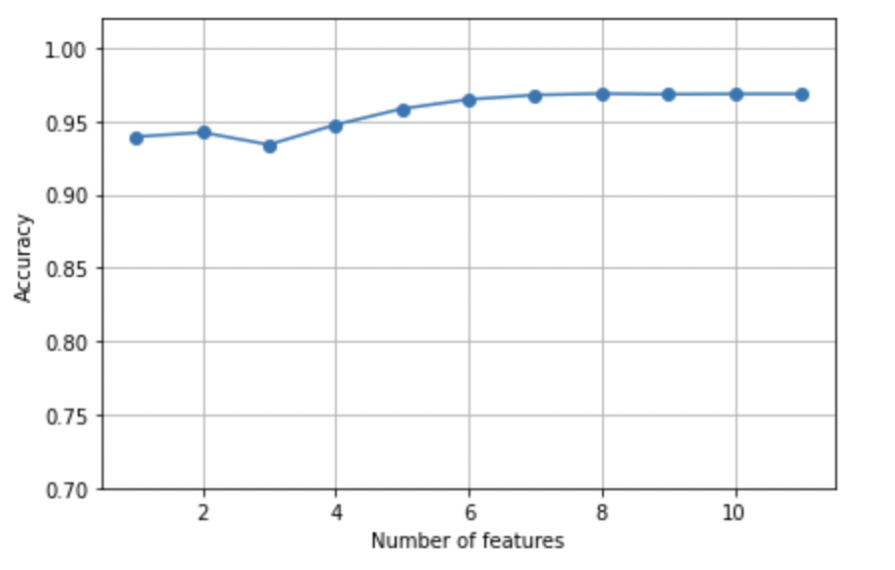
Data Preparation: Feature Selection
-Use Sequential Backward Elimination on kNN
-Keep all attributes

Slide 16
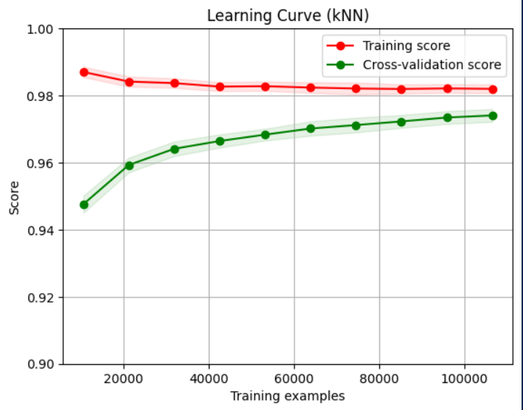
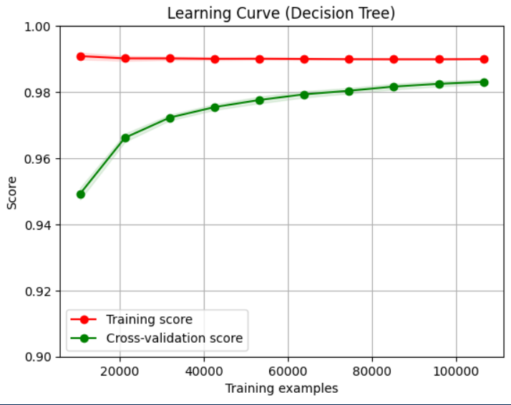
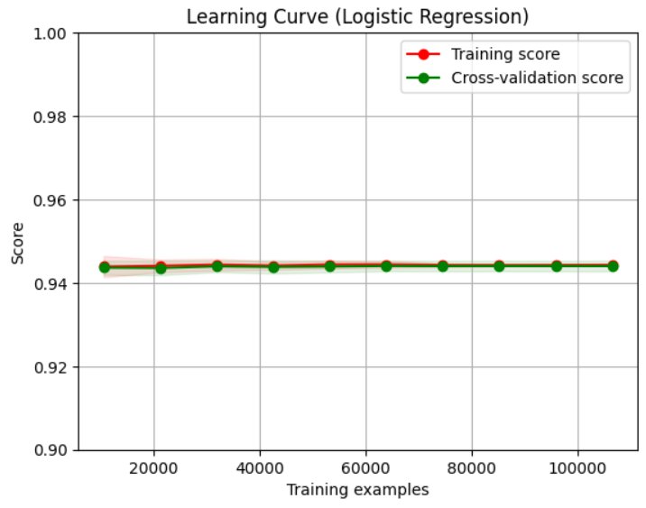
Data Preparation: Learning Curve
-Use learning curve to check whether reducing training instance would worsen model performance
-Performance of Decision Tree and Logistic Regression get worse
-Use whole dataset
kNN
Decision Tree
Logistic Regression

Slide 17
Modeling
Train three different models to determine the best performing one:
Logistic Regression, k-NN, Decision Tree
Use nested cross-validation with hyperparameter search
5 folds in the inner and outer loops
Recall scoring metric - Get rid of FN as much as possible
Utilize a grid search for hyperparameter tuning
Conduct additional data preparation for the k-NN model
Standardize numeric & ordinal features

Slide 18
Modeling Results
Nested Cross Validation with 5 folds, scoring on recall
Model | Decision Tree | k-NN | Logistic Regression
Hyperparameters | {'criterion': 'gini', 'max_depth': None, 'min_samples_leaf': 1, 'min_samples_split': 4} | {'knn__n_neighbors': 11, 'knn__weights': 'distance'} | {'C': 1, 'penalty': 'l2'}
Non-nested CV recall | 0.9858 | 0.9736 | 0.9493
Nested CV recall | 0.9859 +/- 0.0005 | 0.9735 +/- 0.0010 | 0.9493 +/- 0.0008

Slide 19
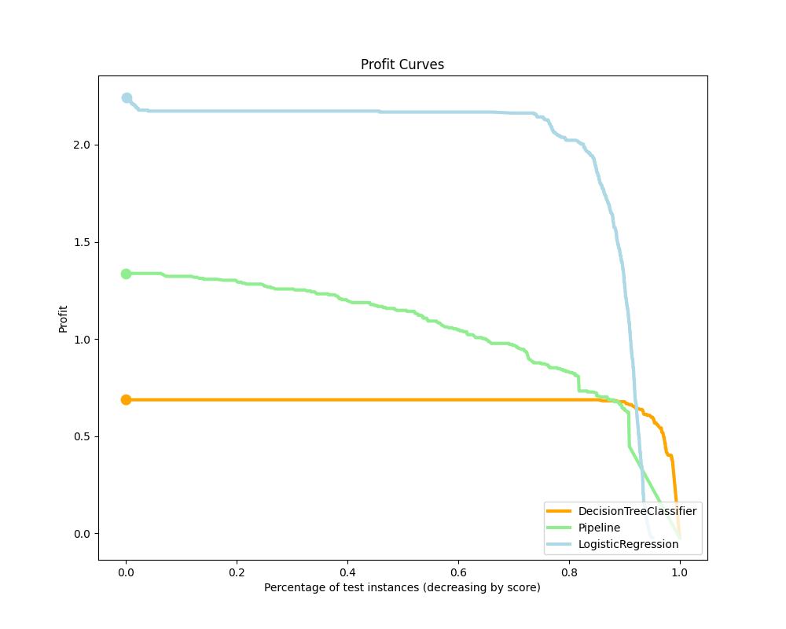
Profit Curve
Profit of TP = 99;
Profit of FP = -1;
Profit of FN = 0;
Profit of TN = 0;
Logistic Regression model has the highest expected profit.

Slide 20
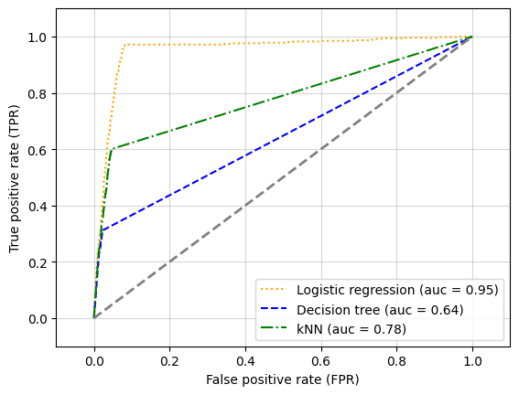
Evaluation
Performance of models with best parameters on test set
Logistic Regression is the best model
Model | Decision Tree | k-NN | Logistic Regression
Recall score (out-of-sample) | 0.6439 | 0.7399 | 0.9440
Recall score (in-sample) | 0.9914 | 0.9914 | 0.9914

Slide 21
Deployment
Predict the response rate of email marketing campaigns before their start
Evaluate the success of different campaigns
Are customers continuing to click?
This model uses data with no personal demographic information so there are few ethical concerns
Uses info on past response statistics
The model has few features it is predicting on but is able to perform reliably
False positive is very cheap, but false negative can miss potential customer

Slide 22
Thank you

